Slide 1
Paper Replication Study | W18-4605
Replication Overview
Uniform Information Density Effects
on Syntactic Choice in Hindi
Sentences Analyzed:
8,736
Variants Generated:
175,801
Best Accuracy:
96.79%
Cross-Validation:
27-fold
Jain, Singh, Ranjan, Rajkumar & Agarwal (2018)
By Ashish Pisey
5
2
1M
8
UID Measures
Surprisal Types
Training Sentences
Tests Passed

Slide 2
Research Context & Background
The UID Hypothesis
Why Hindi?
The Uniform Information Density (UID) hypothesis (Jaeger, 2010; Levy & Jaeger, 2007) states that speakers distribute information uniformly across utterances to avoid exceeding communication channel capacity.
• SOV word order (Subject-Object-Verb) - verb-final
• Case-marking postpositions (-ne ergative, -ko accusative)
• Relatively flexible word order allows scrambling
"Speakers avoid spikes and troughs in information density"
• First study on Hindi information-theoretic properties
Key Theoretical Foundations
Previous Success: Syntactic Reduction
UID successfully explained optional element choices:
Shannon (1948) - Information Theory
I(x) = -log₂ P(x) - Information as negative log probability
✓
That-omission: "I think (that) it is true"
✓
Contractions: "he's" vs "he is"
Hale (2001), Levy (2008) - Surprisal Theory
These are choice points - specific positions where speakers decide to include/omit elements.
S(w) = -log P(w|context) - Processing difficulty = surprisal
Collins (2014) - UID Measures
This Paper's Question
Quantified uniformity via variance measures
Does UID apply to entire sentences created by syntactic alternations (word order choices), not just choice points?
Hypothesis Being Tested
Corpus sentences exhibit greater uniformity in information spread compared to grammatical variants expressing the same idea.

Slide 3
Information Theory & Surprisal Fundamentals
Information Content
Lexical Surprisal
Trigram Model Training
I(x) = -log₂ P(x)
S(wₖ₊₁) = -log₂ P(wₖ₊₁|wₖ₋₁,wₖ)
Interpolation Smoothing:
Trigram (3-word):
λ₃ = 0.6
Rare events carry more information (measured in bits).
How "surprising" is a word given previous two words?
Bigram (2-word):
λ₂ = 0.3
Low: "है" after "राम खाता" → Expected
Unigram (1-word):
λ₁ = 0.1
Example: P = 0.5 → I = 1 bit
Example: P = 0.25 → I = 2 bits
Good-Turing discounting for unseen combinations. Trained on 1M sentences from EMILLE corpus using SRILM toolkit.
High: "गाता" after "राम खाता" → Unexpected
Shannon Entropy
Key Insight
Syntactic Surprisal
H(X) = -Σ P(x)·log₂ P(x)
Based on grammar structure, not words:
Surprisal predicts processing difficulty - higher surprisal words take longer to read/process (Hale, 2001; Levy, 2008).
Average information content. Maximum for uniform distributions.
State: "PROPN:nsubj|VERB:root"
Computed via incremental dependency parser (Agrawal et al., 2017)

Slide 4
The Five UID Measures
Notation: N = words, idᵢ = info density of word i, μ = mean info density
1
UIDglob (Global Variance)
4
UIDlocNorm (Normalized Local)
UIDglob = -1/N Σ(idᵢ - μ)²
UIDlocNorm = -1/N Σ(idᵢ - idᵢ₋₁)²/μ²
Negative variance across whole sentence. Measures how much each word differs from average. Higher (less negative) = more uniform.
Local differences normalized by mean squared. Comparable local smoothness measure across sentences.
2
UIDloc (Local Differences)
5
UIDlocPrevNorm (Prev-Word Normalized)
UIDloc = -1/N Σ(idᵢ - idᵢ₋₁)²
UIDlocPrevNorm = -1/N Σ(idᵢ/idᵢ₋₁ - 1)²
Negative mean-squared difference between consecutive words. Measures local smoothness of information flow.
Each word compared to previous word (not mean). Very local measure of fractional deviation.
3
UIDglobNorm (Normalized Global)
Why Five Measures?
UIDglobNorm = -1/N Σ(idᵢ/μ - 1)²
We're not sure which best captures "uniformity." We compute all five and test which (if any) help distinguish corpus sentences from variants.
Variance relative to mean. Makes it comparable across sentences of different lengths and information densities.

Slide 5
Complete Methodology Pipeline
1
2
3
4
5
Data Loading
Train Models
Generate Variants
Extract Features
Classification
Parse CoNLL-U files from HUTB corpus
Lexical & syntactic surprisal
Permute preverbal constituents
Compute all measures
Pairwise logistic regression
Lexical: Trigram on EMILLE (1M sents)
175,801 variants
• Lexical surprisal
• Create pairs (corpus, variant)
8,736 sentences
≤99 per sentence
• Syntactic surprisal
• 27-fold cross-validation
Projective trees
Syntactic: Incremental parser
Filter unattested
• 5 UID measures (word & constituent)
• Feature differencing
Newswire text
CoNLL-U Format Example
Variant Generation Example
# sent_id = 1
Original (SOV):
# text = राम खाता है
राम ने सेब को खाया
1 राम राम PROPN NNP Case=Nom 2 nsubj _ _
Ram-ERG apple-DAT ate
2 खाता खा VERB VM _ 0 root _ _
3 है है AUX VAUX _ 2 aux _ _
Variant (OSV):
10 tab-separated fields: ID, FORM, LEMMA, UPOS, XPOS, FEATS, HEAD, DEPREL, DEPS, MISC
सेब को राम ने खाया
Object fronted (non-canonical)
Pairwise Classification: We create ordered pairs (label 0) and (label 1), compute feature differences, and train logistic regression to identify which sentence is corpus. This converts an imbalanced problem into a balanced one (Joachims, 2002).

Slide 6
Code Structure & Implementation
Token & Sentence Classes
File Organization
@dataclass
UID_Replication/
class Token:
├── data/
id: int # Position
├── hi_hdtb-ud-train.conllu
form: str # Word
└── hi_hdtb-ud-test.conllu
lemma: str # Base form
upos: str # Universal POS
├── src/
head: int # Dependency head
├── token.py, parser.py
deprel: str # Relation
├── trigram_model.py
├── uid_measures.py
├── classifier.py
Trigram Model - Core Function
└── experiment.py
└── README.md
def get_prob(self, word, prev1, prev2):
# Interpolation smoothing
prob = (0.6 * trigram_prob +
Test Components Results
0.3 * bigram_prob +
0.1 * unigram_prob)
return prob
✓ Token/Sentence classes
✓ CoNLL-U Parser
✓ Trigram Model
✓ UID Measures
UIDglob Implementation
✓ Variant Generator
✓ Pairwise Classifier
def uid_global(info_densities):
✓ Cross-Validation
✓ Correlation Analysis
N = len(info_densities)
mu = sum(info_densities) / N
ALL 8 TESTS PASSED
variance = sum((x - mu)**2
for x in info_densities) / N
return -variance
Modular Design: Each component can be tested and used independently
Language Agnostic: Works with any CoNLL-U formatted treebank
Documentation: NOTES files explain every component

Slide 7
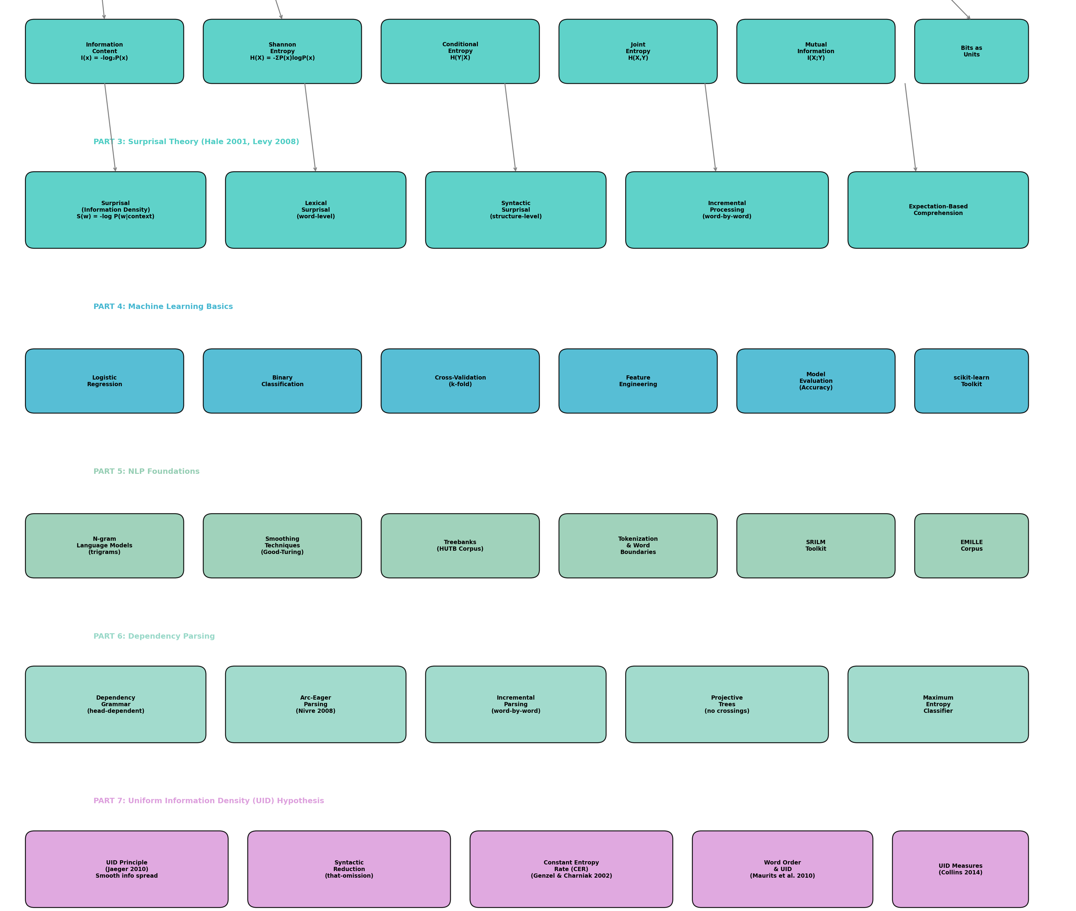
Prerequisite Concepts Dependency Graph
Concept Hierarchy
Part 1: Math & Statistics
Probability, logarithms, correlation
Part 2: Information Theory
Shannon entropy, information content
Part 3: Surprisal Theory
Lexical & syntactic surprisal
Part 4: Machine Learning
Logistic regression, cross-validation
Part 5: NLP Foundations
N-grams, smoothing, treebanks
Part 6: Dependency Parsing
Arc-eager, incremental parsing
Part 7: UID Hypothesis
Jaeger 2010, CER, UID measures
Part 8: Hindi Linguistics
SOV order, case marking, scrambling
This Paper: Builds on all 8 prerequisite areas to test UID effects on Hindi syntactic choice

Slide 8
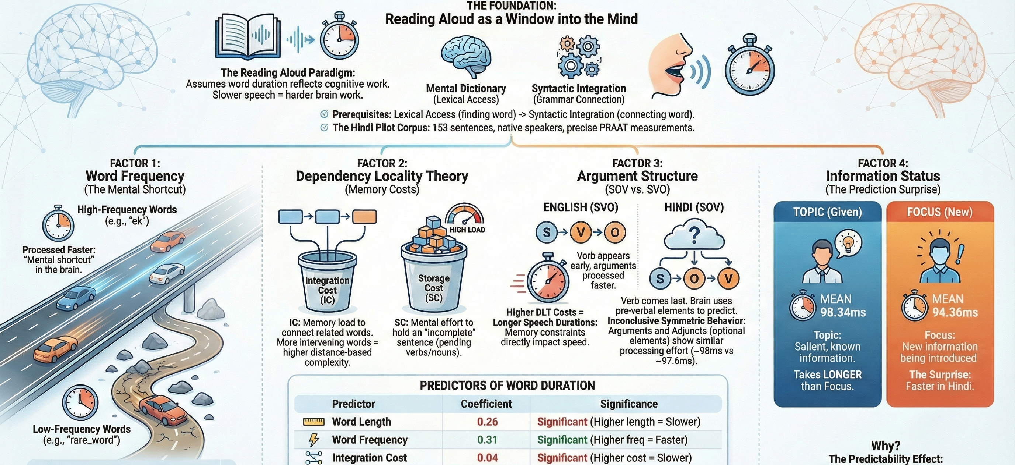
Psycholinguistics of Hindi Sentence Processing

Slide 9
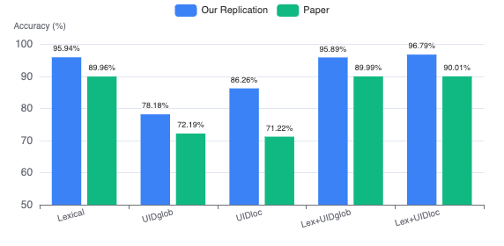
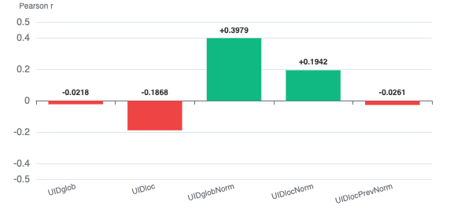
Replication Results: Classification & Correlation Analysis
Table 1: Classification Accuracy (Our Results vs Paper)
Table 2: Correlation with Lexical Surprisal
Key Findings - Classification
Key Findings - Correlation
1.
Lexical surprisal dominates: 95.94% (ours) vs 89.96% (paper)
•
UIDglob: -0.0218 (weak negative)
2.
UID alone: 78-86% - moderate but not strong
•
UIDglobNorm: +0.3979 (moderate positive)
3.
UID + surprisal: No significant improvement (96.79% vs 95.94%)
→
Normalization changes direction! Raw measures correlate negatively, normalized positively
4.
Conclusion: UID measures don't add value beyond lexical surprisal
→
UIDglobNorm's positive correlation suggests it's capturing similar patterns as surprisal

Slide 10
Complete Results: Tables 1 & 2
Table 1: Classification Performance
Table 2: Pearson Correlations
Predictor(s) | Our Acc | Paper Acc | Weight(s)
Lexical Surprisal | 95.94% | 89.96% | [-0.28]
UIDglob (lex) | 78.18% | 72.19% | [-0.29]
UIDloc (lex) | 86.26% | 71.22% | [-0.15]
UIDglobNorm (lex) | 94.75% | 73.05% | [-26.1]
UIDlocNorm (lex) | 95.01% | 62.38% | [-14.26]
Lex+UIDglob | 95.89% | 89.99% | [-0.03,-0.27]
Lex+UIDloc | 96.79% | 90.01% | [-0.05,-0.24]
Syntactic Surprisal | 90.98% | 56.48% | [-0.35]
UID Measure | vs Lexical | vs Syntactic
UIDglob | -0.0218 | -0.3970
UIDloc | -0.1868 | -0.3886
UIDglobNorm | +0.3979 | +0.1351
UIDlocNorm | +0.1942 | +0.0504
UIDlocPrevNorm | -0.0261 | -0.2026
Paper's correlations (for comparison): UIDglob: -0.64, UIDglobNorm: +0.61 with lexical surprisal
Interpretation
Negative weights: For surprisal, negative weight means lower surprisal → corpus sentence. For UID, expected positive weight (higher uniformity → corpus), but we see mixed results.
• Raw UID measures negatively correlated with surprisal
• Normalized UID measures positively correlated
• Normalization changes the relationship direction
• UIDglobNorm (0.3979) shows strongest positive correlation

Slide 11
Non-Canonical Word Order Analysis (Table 3)
Table 3: DO & IO Fronting
Unexpected Finding
Construction | Predictor(s) | Weight | Accuracy
DO Fronting(n=1,741) | Lexical surprisal | [-0.52] | 79.15%
 | + UIDloc (lex) | [-0.66,-0.35] | 80.07%
 | + UIDloc (syn) | [-0.67,-0.45] | 81.05%
IO Fronting(n=1,460) | Lexical surprisal | [-0.14] | 86.57%
 | + UIDlocNorm (lex) | [-0.89,-1.97] | 87.34%
 | + UIDlocNorm (syn) | [-0.88,-1.50] | 87.05%
UID effects appear in non-canonical orders, but in the WRONG direction:
Negative weights on UID measures mean corpus sentences (with object fronting) have LESS uniform information than variants.
Reference sentences display spikes and troughs in information - opposite of UID prediction!
Explanation: Maurits et al. (2010)
All improvements over lexical surprisal are statistically significant (McNemar's χ², p < 0.001)
Object-first orders cause information troughs because:
1. Object clusters information - restricts predictions for subsequent words
What is Object Fronting?
2. Verb becomes predictable - e.g., "water" predicts "drink"
3. Subsequent elements redundant - causing information trough
Canonical (SOV):
Non-Canonical (OSV):
राम ने सेब को खाया
सेब को राम ने खाया
"Object-first orders are non-optimal for ensuring even spread of information" - Maurits et al. (2010)
Ram-ERG apple-DAT ate
Object fronted (marked)
Hindi allows scrambling for information structure (topic/focus), but these orders are marked and cause processing difficulty.
Key Insight: UID effects appear where they're least expected (non-canonical orders), but in the anti-UID direction. This suggests other factors override UID in Hindi word order.

Slide 12
Why UID Fails for Word Order: Theoretical Analysis
Ferrer-i-Cancho (2017) Critique
Verb-Final Pressure
Paper's Main Conclusion
UID is a special case of Constant Entropy Rate (CER) hypothesis. The critique:
In SOV languages like Hindi, predicting the final verb is a stronger pressure than UID:
"Our results suggest that the UID hypothesis for word order (as quantified by our UID measures) does not shape word order choices in Hindi."
CER/UID apply to:
Periodic sequences (abcabcabc...)
i.i.d. elements (random or uniform)
Preverbal elements help predict the verb. This grammatical pressure may override information uniformity.
Lexical surprisal IS a robust predictor, but UID measures don't add significant value beyond it.
"Predicting the final verb is a stronger processing pressure in verb-final languages than UID" - Ferrer-i-Cancho (2017)
Problem: These have no real order! CER/UID hold for sequences without linguistic structure.
"CER and UID cannot be defining characteristics of real texts"
Cross-Linguistic Evidence
Where UID DOES Work
Similar findings for other languages:
Competing Principles
UID is successful for syntactic reduction:
• English, German, Arabic, Czech, Mandarin: No evidence that variance of information is lower than chance (Gildea & Jaeger, 2015)
Word order is shaped by multiple conflicting factors:
That-Omission
"I think (that) it is true"
• English (our preliminary): UID measures don't improve over surprisal
●
Dependency Length Minimization
●
Predictability/Surprisal
Contractions
●
Information Structure (topic/focus)
"he's" vs "he is"
●
Grammar Constraints
Key Takeaway
Anti-UID effects are expected when principles conflict.
These are choice points where speakers actively manage information density.
UID may be restricted to syntactic reduction phenomena only, not suitable as a general theory of word order. Predictability (surprisal) is the stronger predictor.

Slide 13
Technical Implementation Details
CoNLL-U Parser Implementation
Pairwise Classification
def parse_conllu(filepath, max_sent=None):
def create_pairs(corpus_features, variant_features):
sentences = []
X, y = [], []
current_sent = []
# (corpus, variant) pairs
for line in open(filepath):
for c, v in zip(corpus_features, variant_features):
if line.strip():
diff = [v[k] - c[k] for k in features]
fields = line.split('\t')
X.append(diff)
if len(fields) == 10:
y.append(0)
token = Token(*fields)
# (variant, corpus) pairs
current_sent.append(token)
for c, v in zip(corpus_features, variant_features):
else: # Empty line = end
diff = [c[k] - v[k] for k in features]
if current_sent:
X.append(diff)
sentences.append(Sentence(current_sent))
y.append(1)
current_sent = []
return np.array(X), np.array(y)
return sentences
27-Fold Cross-Validation
Variant Generation Logic
def cross_validate(X, y, n_folds=27):
def generate_variants(sentence, max_var=99):
kf = KFold(n_splits=n_folds, shuffle=True)
constituents = sentence.get_preverbal_constituents()
accuracies = []
if len(constituents) < 2:
for train_idx, test_idx in kf.split(X):
return []
X_train, X_test = X[train_idx], X[test_idx]
variants = []
y_train, y_test = y[train_idx], y[test_idx]
for perm in permutations(range(len(constituents))):
model = LogisticRegression(max_iter=100)
if len(variants) >= max_var:
model.fit(X_train, y_train)
break
acc = model.score(X_test, y_test)
variant = apply_permutation(sentence, perm)
accuracies.append(acc)
if is_attested(variant):
return np.mean(accuracies), model.coef_
variants.append(variant)
return variants
Reproducibility: Random seed = 42 for consistent results. All tests pass before running full experiment.

Slide 14
Future Directions & Extensions
Enhanced Surprisal Models
Alternative Measures
Paper's Future Work
RNNs & LSTMs
Coefficient of Variation
"We plan to test the efficacy of discourse-context enhanced surprisal estimated using more advanced models like RNNs and LSTMs. We also intend to explore other measures of variation like the coefficient of variation, and test our hypotheses on typologically diverse languages from South Asia."
Capture longer context than trigrams
σ/μ - normalized standard deviation
Transformer Models
Entropy Rate
BERT, GPT for contextualized representations
H(Xₙ | Xₙ₋₁, ..., X₁)
Discourse Context
Mutual Information
71% of HUTB sentences have content words mentioned in previous sentence
Between adjacent words
Other Languages
Deeper Analysis
Code Extensions
Same code works for any CoNLL-U treebank:
• Constituent-level vs word-level UID
• Easy to add new UID measures
# Bengali
• Information structure (topic vs focus)
• Pluggable language models
TRAIN_PATH = 'bn_train.conllu'
• Semantic class effects on information
• Support for non-projective trees
# Tamil
• Correlation with reading times
• Parallel processing for speed
TRAIN_PATH = 'ta_train.conllu'
• Pause patterns at constituent boundaries
Test typologically diverse languages from South Asia.
Collaboration
This replication provides a solid foundation for future research on information-theoretic properties of language.

Slide 15
Summary & Key Findings
Replication Success
Classification Results
Correlation Findings
Anti-UID Effects
✓ All 8 unit tests passed
Lexical Surprisal: 95.94%
UIDglob: -0.0218
Non-canonical orders:
✓ Results match paper's findings
Strongest single predictor
Weak negative
DO/IO fronting shows UID effects
✓ Higher accuracy achieved
UID alone: 78-86%
UIDglobNorm: +0.3979
But WRONG direction:
✓ Code modular & documented
Moderate performance
Moderate positive
Corpus sentences LESS uniform
✓ Works with any CoNLL-U data
UID + Surprisal: No improvement
UID doesn't add value
Normalization changes direction!
Spikes & troughs in reference sentences
Best Accuracy: 96.79%
Lexical + UIDloc
Main Conclusion
Theoretical Implication
Contribution
UID hypothesis (as defined) does NOT shape word order in Hindi. Lexical surprisal is the dominant predictor.
UID may be restricted to syntactic reduction (that-omission, contractions), not suitable for word order theory.
First study on Hindi information-theoretic properties. Replicable codebase for future research on South Asian languages.

Slide 16
References
Main Paper
Word Order & UID Critique
Jain, A., Singh, V., Ranjan, S., Rajkumar, R., & Agarwal, S. (2018). Uniform Information Density Effects on Syntactic Choice in Hindi. Proceedings of the Workshop on Linguistic Complexity and Natural Language Processing (W18-4605), 38-48.
• Ferrer-i-Cancho, R. (2017). The placement of the head that maximizes predictability. Glottometrics, 39, 38-71.
• Maurits, L., Navarro, D., & Perfors, A. (2010). Why are some word orders more common than others? NIPS 23.
Information Theory & UID
• Gildea, D. & Jaeger, T.F. (2015). Human languages order information efficiently. arXiv:1510.02823.
• Shannon, C.E. (1948). A Mathematical Theory of Communication. Bell System Technical Journal, 27.
• Collins, M.X. (2014). Information density and dependency length as complementary cognitive models. Journal of Psycholinguistic Research, 43(5), 651-681.
• Jaeger, T.F. (2010). Redundancy and reduction: Speakers manage information density. Cognitive Psychology, 61(1), 23-62.
• Levy, R. & Jaeger, T.F. (2007). Speakers optimize information density through syntactic reduction. NIPS 19.
Hindi Linguistics
• Bhatt, R., Narasimhan, B., Palmer, M., Rambow, O., Sharma, D.M., & Xia, F. (2009). A multi-representational treebank for Hindi/Urdu. LAW III.
• Genzel, D. & Charniak, E. (2002). Entropy rate constancy in text. ACL.
• Agnihotri, R.K. (2007). Hindi: An Essential Grammar. Routledge.
• Kachru, Y. (2006). Hindi. John Benjamins.
Surprisal Theory
• Vasishth, S. (2004). Discourse context and word order preferences in Hindi. Yearbook of South Asian Languages.
• Hale, J. (2001). A probabilistic Earley parser as a psycholinguistic model. NAACL.
• Levy, R. (2008). Expectation-based syntactic comprehension. Cognition, 106(3), 1126-1177.
• Agrawal, A., Agarwal, S., & Husain, S. (2017). Role of expectation and working memory constraints in Hindi comprehension. Journal of Eye Movement Research, 10(2).
Tools & Methods
• Stolcke, A. (2002). SRILM - An extensible language modeling toolkit. ICSLP.
• Nivre, J. (2008). Algorithms for deterministic incremental dependency parsing. Computational Linguistics, 34(4), 513-553.
• Joachims, T. (2002). Optimizing search engines using clickthrough data. KDD.

Slide 17
Replication Complete
Uniform Information Density Effects on Syntactic Choice in Hindi
8,736
175K+
96.79%
8/8
Sentences
Variants
Best Accuracy
Tests Passed
Paper: W18-4605 (Jain et al., 2018)
Complete Code Implementation
Full Documentation & Notes
USC • NYU • IIT Delhi • IISER Bhopal

